Slide 1
King County, USA House Sales Tinotenda Muchenje CSIT 558 Predictive Mining

Slide 2
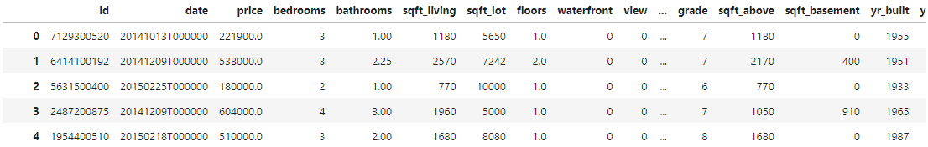
Project analysis slide 2
Description of Dataset
Introduction:
This presentation is on the analysis of house sales data in King County, USA from 2014 to 2015. In this study, we will explore a comprehensive dataset obtained from https://www.kaggle.com/datasets/harlfoxem/housesalesprediction/data. This dataset consists of 21613 rows and 21 columns, providing valuable information about the prices of houses and the features they come with. The dataset encompasses various aspects, including the price of the house, bedrooms, bathrooms, square feet, and condition, among others.
Objective:
The primary objective of this project is to leverage the potential of predictive data mining on a comprehensive house sales dataset. By employing cutting-edge techniques such as Linear Regression, Decision Tree, and Naive Bayes, aiming to unlock the hidden patterns and correlations within the given and existing data. The ultimate goal is to develop robust and accurate models that can predict house prices with unprecedented precision.

Slide 3
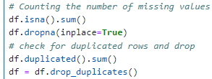
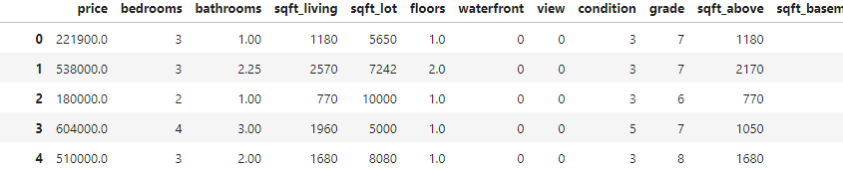
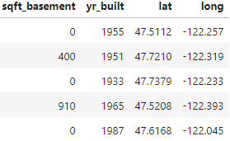
Project analysis slide 2
Data Preprocessing
Data Cleaning:
The following steps were carried out while performing data cleaning:
1. Eliminating empty values
2. Eliminating duplicated values
3. Dimensionality reduction, removal of non-informative features
The following snippet displays the resulting data frame after the completion of data cleaning and the conversion of categorical columns into numeric representations.
After cleaning, the dataset contains 21613 rows and 15 columns.

Slide 4
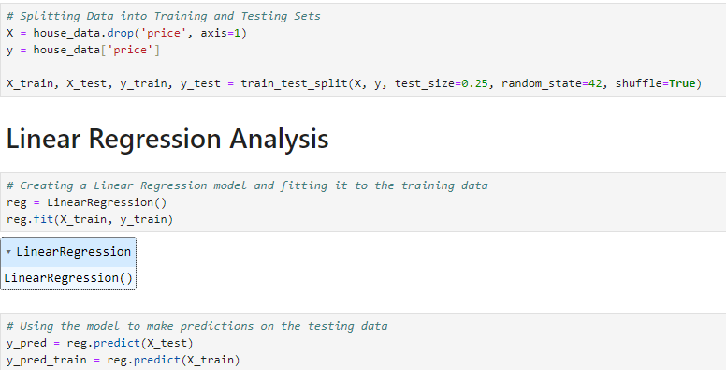
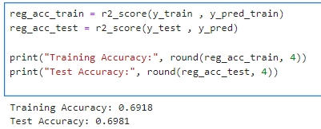
Project analysis slide 2
Linear Regression Analysis
The objective of utilizing linear prediction on house sales data is to develop a model that can effectively estimate house prices based on a set of input variables. By leveraging the simplicity and interpretability of linear regression, we aim to identify the key factors that influence house prices and quantify their impact accurately.
Training and Test Accuracy: The model produced, the training accuracy of 0.6918 and the test accuracy of 0.6981 which, suggest that the model performs consistently on both the training and testing datasets. These accuracy values represent the proportion of correctly predicted house prices in each dataset. The closeness of the training and test accuracies indicates that the model generalizes well to unseen data, which is a positive outcome.

Slide 5
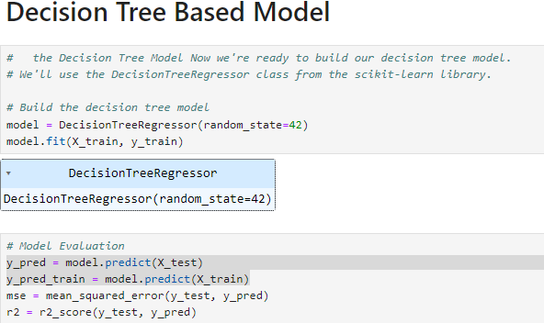
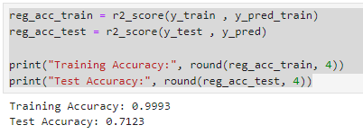
Project analysis slide 2
Decision Tree Based Model
The objective of using a decision tree-based model on house sales data is to capture complex relationships and interactions between independent variables and house prices. By leveraging the flexibility and interpretability of decision trees, the aim is to develop a predictive model that can accurately estimate house prices based on various features such as location, size, amenities, and other relevant factors.
Training and Test Accuracy: The training accuracy of 0.9993 and the test accuracy of 0.7123 represent the proportion of correctly predicted house prices in the training and test datasets, respectively. These accuracy values demonstrate the model's performance in correctly classifying or predicting house prices. The high training accuracy suggests that the model has effectively learned the patterns and relationships present in the training data. The test accuracy, which is slightly lower than the training accuracy, indicates that the model is generalizing well to unseen data and is performing well on new instances.

Slide 6
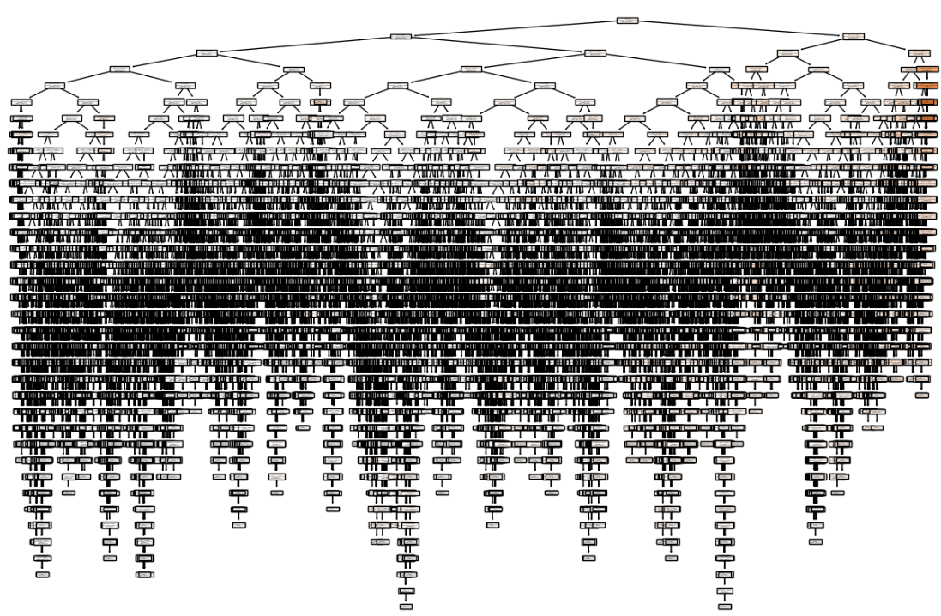
Project analysis slide 2
Decision Tree

Slide 7
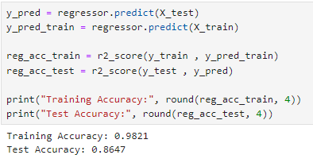
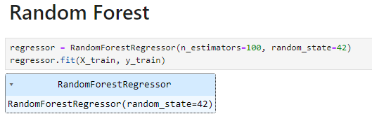
Project analysis slide 2
Random Forest
The objective of utilizing Random Forest after using a decision tree, is to potentially enhance the predictive accuracy, robustness, and generalization capabilities of the model. It allows us to leverage the strengths of both approaches to achieve better results in predicting house prices and gain additional insights into the importance of different features. Why Random Forest? The Random Forest model demonstrates its superiority over the decision tree model. The ensemble nature of Random Forest, which combines multiple decision trees, allows it to capture more complex relationships, reduce overfitting, and provide more robust predictions.
Comparing the results of the Random Forest model with the previous decision tree model:
Training Accuracy: The Random Forest model has a slightly lower training accuracy (0.9821) compared to the decision tree model (0.9993). This difference can be attributed to the randomization and diversity introduced in the Random Forest, which helps reduce overfitting and improve generalization performance.
Test Accuracy: The Random Forest model outperforms the decision tree model in terms of test accuracy. The Random Forest achieves a test accuracy of 0.8647, while the decision tree model had a test accuracy of 0.7123. This improvement suggests that the Random Forest model has better generalization capabilities and is more effective at making accurate predictions on unseen data.

Slide 8
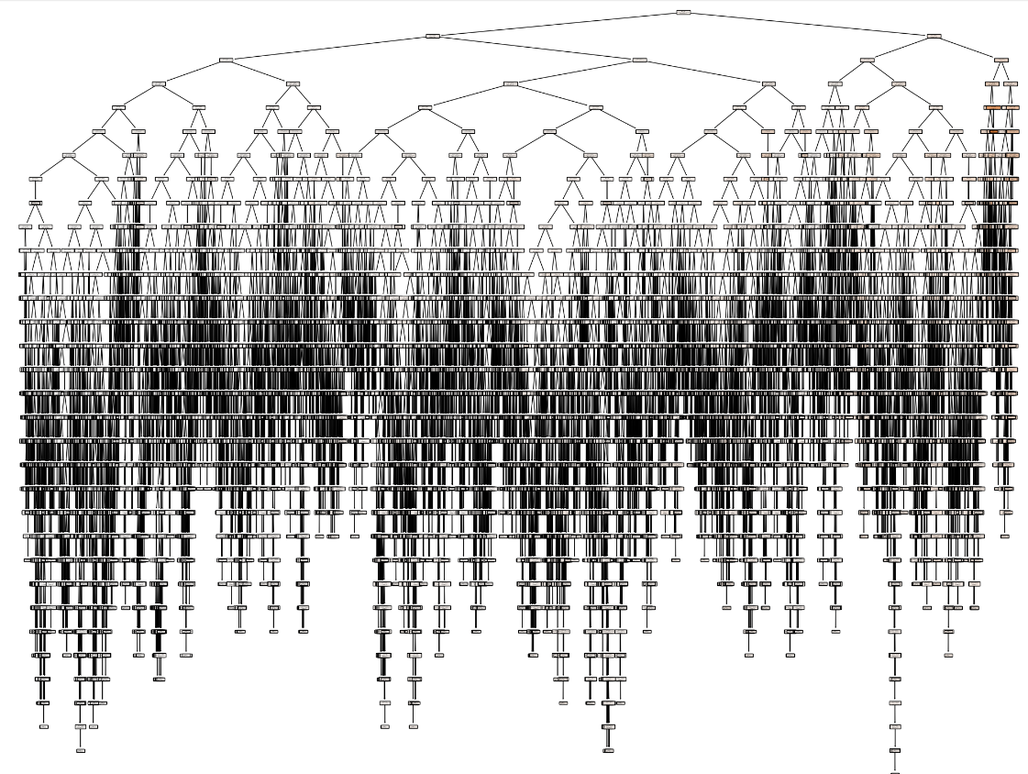
Project analysis slide 2
Random Forest

Slide 9
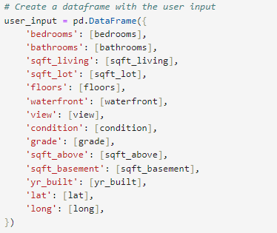
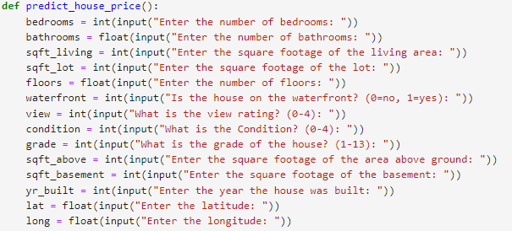
Project analysis slide 2
Experiments
Various experiments were conducted on the data to evaluate the outcomes of the three models: linear regression, decision tree, and random forest. These experiments involved using user inputs to examine the degree of correlation between the prediction results generated by each model. The goal here is to predict the price of a house given the preferred feature values of each buyer:
By maintaining consistent values for these parameters across all three models, we will establish a fair and controlled experimental setup. This allows for meaningful comparisons of their performances and enables us to draw conclusions about the relative strengths and weaknesses of each model in predicting house prices accurately.

Slide 10
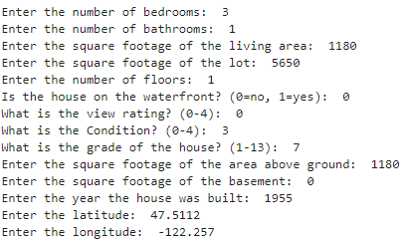
Project analysis slide 2
User Input 1
The goal here is to predict the price of a house given the preferred feature values of each buyer:
RESULTS
Linear Regression:
Predicted Price – $268 248
Decision Tree:
Predicted Price – $289 900
Random Forest:
Predicted Price - $252 436
From these results, we can draw the following conclusions:
Model Variability: The predicted prices from each model differ from one another. This indicates that the models have distinct approaches to predicting house prices and may consider different features or capture different patterns in the data.
Model Performance: The predicted prices from the Decision Tree model ($289,900) and the Linear Regression model ($268,248) are relatively close, while the Random Forest model predicts a lower price ($252,436). This suggests that the Decision Tree and Linear Regression models may have similar performance levels, whereas the Random Forest model performs differently.

Slide 11
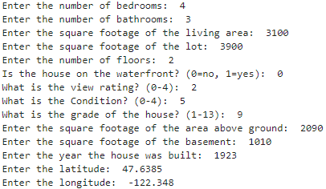
Project analysis slide 2
User Input 2
The goal here is to predict the price of a house given the preferred feature values of each buyer:
RESULTS
Linear Regression:
Predicted Price – $1 172 970
Decision Tree:
Predicted Price – $1 450 000
Random Forest:
Predicted Price - $1 299 571
In this experiment, The user input was taken from the dataset, and the house price for that particular row was $1,450,000.

Slide 12
Project analysis slide 2
User Input 2 Cntd….
Comparing the predicted prices to the actual price of $1,450,000, we can evaluate the models and draw the following observations:
1. Linear Regression: The Linear Regression model predicted a price of $1,172,970. This prediction is significantly lower than the actual price of $1,450,000. It suggests that the Linear Regression model may not capture the complexity and non-linear relationships present in the data, resulting in an underestimation of the house price.
2. Decision Tree: The Decision Tree model predicted a price of $1,450,000, which is the same as the actual price. This indicates that the Decision Tree model was able to capture the specific features and patterns present in the input data accurately and produced the exact house price. It suggests that the Decision Tree model may have a better ability to handle complex relationships and provide precise predictions for this particular input.
3. Random Forest: The Random Forest model predicted a price of $1,299,571, which is lower than the actual price of $1,450,000. While the Random Forest model takes into account multiple decision trees, the average prediction still falls short of the actual price. This result may indicate that the ensemble of decision trees in the Random Forest did not collectively capture the specific characteristics of this input, leading to a lower prediction.
Overall, based on this specific user input and the comparison to the actual price, the Decision Tree model appears to have performed the best, accurately predicting the house price. The Linear Regression model underestimated the price, while the Random Forest model also fell short but to a lesser extent.

Slide 13
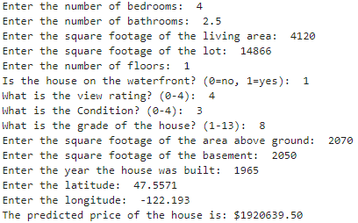
Project analysis slide 2
User Input 3
The goal here is to predict the price of a house given the preferred feature values of each buyer:
RESULTS
Linear Regression:
Predicted Price – $1 651743
Decision Tree:
Predicted Price – $1 851 000
Random Forest:
Predicted Price - $1 920 639
Another experiment was done using, the user input taken from the dataset, and the house price for that particular tuple was $1,851,000.
Decision Tree has again been able to predict the value accurately, linear regression being above the expected value and Random forest being
Above the expected value.

Slide 14
Project analysis slide 2
Conclusion
This project focused on applying various techniques in predictive data mining, specifically utilizing the linear regression, decision tree, and random forest algorithms. Each experiment carried out in this project served a distinct purpose, and the results obtained shed light on the benefits and significance of employing different techniques and conducting multiple experiments.
In the first experiment, the three models (linear regression, decision tree, and random forest) were evaluated using the same user input. The predicted prices varied across the models, indicating their unique approaches to predicting house prices. While the exact superiority of one model over the others could not be determined solely based on the predicted prices, further evaluation using appropriate metrics would be essential in making a more concrete conclusion.
The second experiment involved a different user input, which was taken directly from the dataset, with a known actual house price. The predicted prices from each model were compared to the actual price to evaluate their performance. The Decision Tree model stood out by accurately predicting the actual price, showcasing its ability to capture the specific features and patterns present in the input data. On the other hand, the Linear Regression model underestimated the price, while the Random Forest model fell short but to a lesser extent. This comparison highlighted the strengths and weaknesses of each model in capturing the complexity and non-linear relationships within the data.
The significance of conducting multiple experiments lies in the opportunity to assess different algorithms' performance and compare their predictive capabilities. By exploring various techniques, this project provided insights into the strengths and limitations of each algorithm. The experiments also facilitated the identification of the Decision Tree model as the most accurate in predicting house prices for the given inputs.

Slide 15
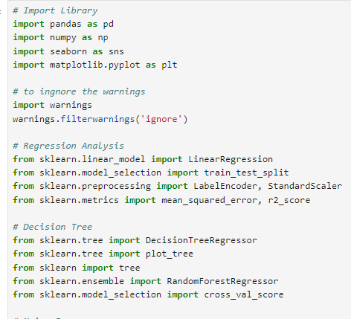
Project analysis slide 2
Python Libraries & References
References
https://www.kaggle.com/datasets/harlfoxem/housesalesprediction/data
https://www.geeksforgeeks.org/regression-in-machine-learning/
https://www.analyticsvidhya.com/blog/2021/08/decision-tree-algorithm/
https://www.geeksforgeeks.org/random-forest-algorithm-in-machine-learning/

Slide 16
Thank You

